Slide 1



EBAY
UNDER GUIDENCE OF MRS.VAISHALI SONAWANE MAM.

Slide 2

INTRODUCTION
My shop is one of the part of the eBay marketplace where users can explore, buy, and sell a wide range of products online.
EBAY IS A GLOBAL E-COMMERCE PLATFORM THAT CONNECTS MILLIONS OF BUYERS AND SELLERS, ENABLING THEM TO TRADE GOODS AND SERVICES IN A SECURE AND CONVENIENT WAY THROUGH ONLINE AUCTIONS AND FIXED-PRICE LISTINGS.

Slide 3

OVERVIEW
What is eBay?
eBay is a global online marketplace that allows users to buy and sell a wide range of products and services.
IT HELPS USERS UNDERSTAND HOW TO LIST PRODUCTS, MANAGE THEIR ONLINE STORE, AND SELL TO A WORLDWIDE AUDIENCE.
EBAY PROVIDES FEATURES LIKE AUCTIONS, FIXED-PRICE LISTINGS, AND SECURE PAYMENT
OPTIONS TO MAKE ONLINE TRADING SIMPLE.

Slide 4

MODULES
MODULE 1 :
USERNAME
Checked the functionalities of username and continue button in the username page
MODULE 2 : PASSWORD
Checked the functionalities of password and continue in the password page
MODULE 3 : SEARCH MULTIPLE ITEMS
Checked the functionalities of search button by searching multiple items

Slide 5
MODULES
MODULE 4 :
ADD TO CART
Checked the functionality of add to cart button by adding an item to the cart.
MODULE 5 : DELETE
Checked the functionality of delete by deleting an item from the cart.
MODULE 6 : CHANGE NAME
Checked the functionality of change name button

Slide 6
MODULES
MODULE 7 :
CHANGE ADDRESS
Checked the functionality of change address button .
MODULE 8 : SHOP BY CATEGORY
Checked the functionality of shop by category button .
MODULE 9 : SHOP BY ALL
Checked the functionality of shop by all button
MODULE 10 : Sign out
Checked the functionality of facebook button

Slide 7
DEFECTS
Footer is different for different pages.
Hovering on deals element it doesn’t showing any popup while others are showing their categories

Slide 8

Defect identifier :- B_001
DEFECT SUMMARY : - Footer alignment is different for different pages
TEST ID :- TC_30
TEST CASE NAME :- TC_Footer
MODULE NAME :- FOOTER
REPRODUCIBLE :-
SEVERITY :- LOW
PRIORITY :- LOW
RAISED BY :- SWAROOP
ASSIGNED TO :- DEVELOPER
DATE OF ASSIGNMENT :- 19/8/2025
STATUS :- PENDING
FIXED BY :- DEVELOPER
DATE OF FIXING :-

Slide 9
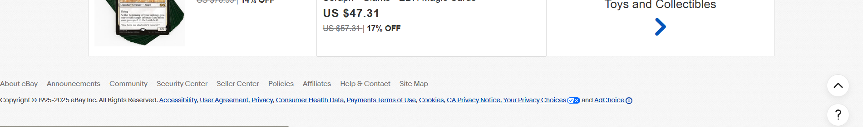
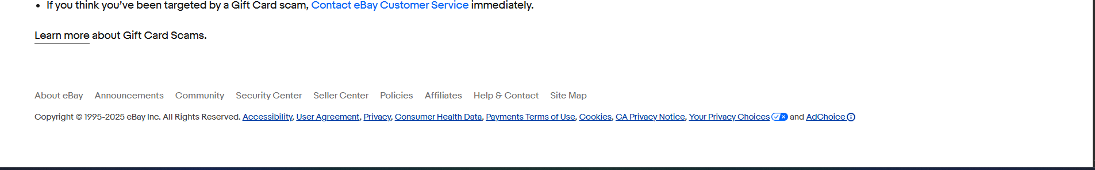
DAILY DEALS
BRAND OUTLET

Slide 10
Defect identifier :- B_001
DEFECT SUMMARY :- Hovering on deals element it doesn’t showing any popup while others are showing their categories
TEST ID :- TC_31
TEST CASE NAME :- TC_hovering_deals
MODULE NAME :-Deals Button
REPRODUCIBLE :-
SEVERITY :- Medium
PRIORITY :- Medium
RAISED BY :-TEAM LEAD
ASSIGNED TO :-DEVELOPER TEAM LEAD
DATE OF ASSIGNMENT :- 19/8/2025
STATUS :- PENDING
FIXED BY :- DEVELOPER
DATE OF FIXING :-

Slide 11
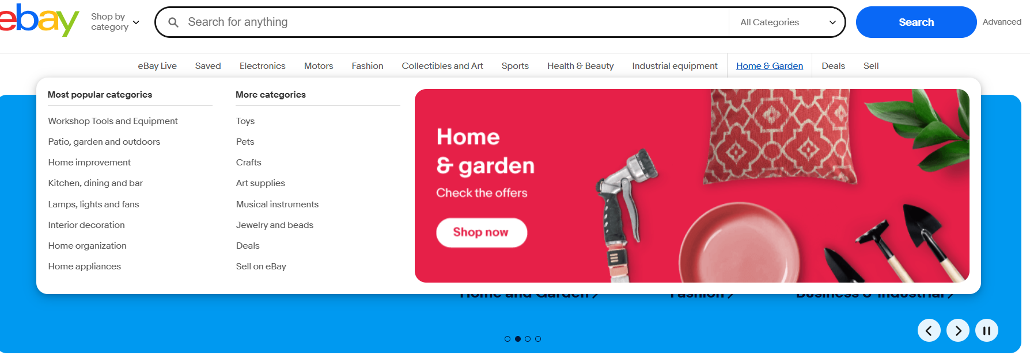
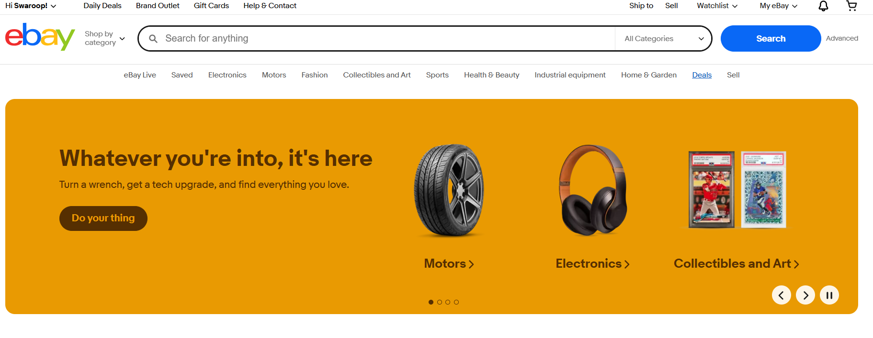

Slide 12
CHALLENGES
ebay uses verfication checks for preventing bots.
This makes it difficult to run automation testing.
Test execution may stop if automation cannot bypass verfication.
SOMETIMES AUTOMATION FAILS BECAUSE OF UNSTABLE
OR SLOW INTERNET.

Slide 13
EXPERIENCE
GAINED HANDS-ON EXPERIENCE IN E-COMMERCE TESTING BY WORKING ON EBAY DEMO SHOP.
LEARNED TO WRITE AND EXECUTE AUTOMATION TEST CASES FOR PRODUCT LISTING, SEARCH, CART, AND CHECKOUT FLOWS.
FACED REAL-WORLD CHALLENGES LIKE CAPTCHA/VERIFICATION, NETWORK ISSUES, AND ELEMENT SYNCHRONIZATION DURING AUTOMATION.

Slide 14
THANK YOU

